Slide 1
MODULE-V
Enterprise JavaBeans
Updated
By:
Shivakumara T
Assistant Professor,
Department of MCA,
BMSITM, Bangalore- 560064

Slide 2
Contents to be discussed
Introduction
Component Types
Container Services
EJB Specifications
Server side component types:
Session Beans
Message Driven Bean
Entity Beans
The Java Persistence Model
Container Services
Dependency
Injection
Concurrency
Instance pooling and caching
Transactions
Security
Timers
Naming and Object stores
Interoperability
Life-cycle call backs,
Interceptors,
platform integration
Developing Your First EJBs
Models
The stateless session bean
The stateful session bean
The single ton session bean
Message Driven Bean
EJB and Persistence –
Persistence Entity Manager Mapping
Persistence Objects
Entity Relationships

Slide 3

Introduction
What Is an Enterprise Bean?
Written in the Java programming language, an enterprise bean is a server-side component that encapsulates the business logic of an application.
The business logic is the code that fulfills the purpose of the application.
In an inventory control application, for example, the enterprise beans might implement the business logic in methods called checkInventoryLevel and orderProduct.
By invoking these methods, remote clients can access the inventory services provided by the application.

Slide 4
ENTERPRISE JAVA BEANS [EJB]
An EJB is a component of the J2EE architecture that primarily provides business logic to a J2EE application and interacts with other server-side J2EE components.

Slide 5
EJB Architecture
Naming Service
Server
Home Interface
(Factory)
Container
RMI
Client
RMI
Remote
Interface
EJB Object
(Wrapper)
Enterprise
Java Bean
(Biz Logic)
You write this
Implements
Invokes
Creates / uses

Slide 6
An EJB is written in the java programming language. So, it supports the platform independent feature.
The EJB Server handles system-level services such as threading, security, transactions, and persistence.
The developer of EJB class focuses on writing business logic rather than system-level services.

Slide 7
Benefits of Enterprise Beans
The EJB container provides system-level services to enterprise beans, the bean developer can concentrate on solving business problems.
The beans—and not the clients—contain the application’s business logic, the client developer can focus on the presentation of the client. The clients are thinner, a benefit that is particularly important for clients that run on small devices.
Enterprise beans are portable components, the application assembler can build new applications from existing beans.

Slide 8
When to Use Enterprise Beans
The application must be scalable.
Transactions must ensure data integrity.
The application will have a variety of clients.

Slide 9
The Problem Domain
Good Software implies:
• Secure
• Sound/maintains integrity
• Scalable
• Interoperable
• Robust/resilient
• Correct/functions as specified
And these are all prerequisites to a finished product, not a single one is specific to any business

Slide 10
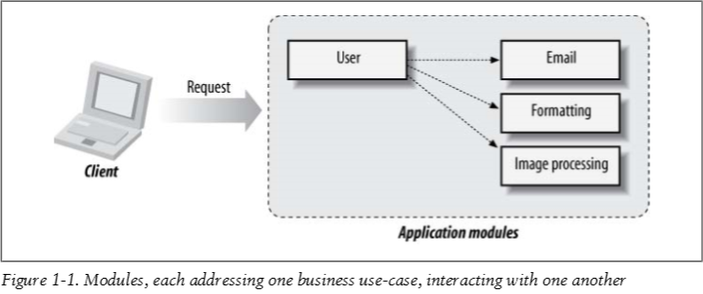
Breaking Up Responsibilities
Categorize all code in a system into one of three flavors:
• Core concerns
• Cross-cutting concerns
• Plumbing

Slide 11
The core is typically going to contain rules unique to your application, and no one can build it aside from you and your team.
core concerns is to reduce or eliminate the energy we spend everywhere else.

Slide 12
Cross-cutting concerns
The core of an application defines its primary function,
There is a host of secondary operations necessary to keep things running correctly and efficiently. Security assertions, transactional boundaries, concurrency policies—all are helpful in ensuring the integrity of the system is in check.
Cross-cutting concerns are intended to stretch across modules

Slide 13
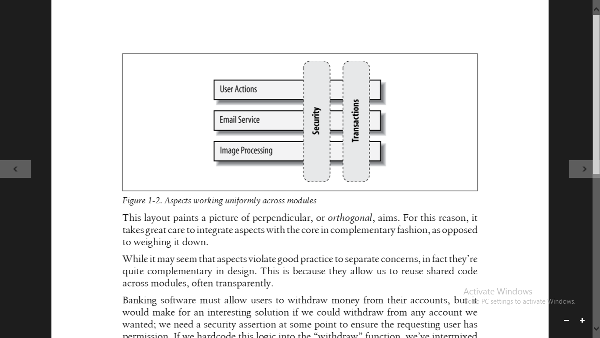
apply security as an common aspect to be shared by many modules and configure where it’s enforced separately.

Slide 14
Plumbing
Plumbing provides this routing, and may take several forms:
• Forwarding control from an HTTP request to some action handler
• Obtaining a JDBC connection or JavaMail session
• Mapping a nonnative request (JSON, ActionScript, RDBMS SQL) into a Java object
Plumbing code is nothing more than an adapter between endpoints and provides few merits of its own

Slide 15
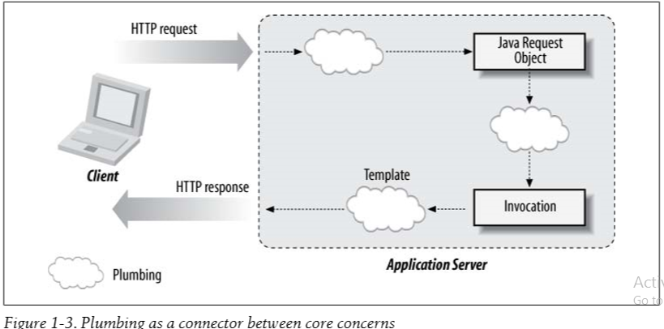

Slide 16
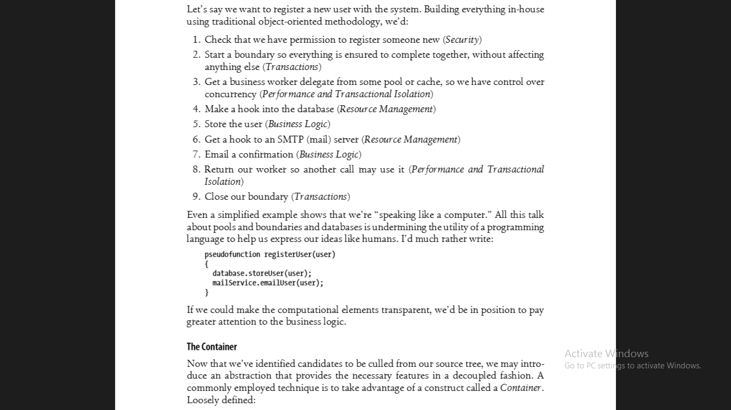
Code Smart, Not Hard
Do Less
Let’s say, we want to register a new user with the system. Building everything in-house using traditional object-oriented methodology, we’d

Slide 18
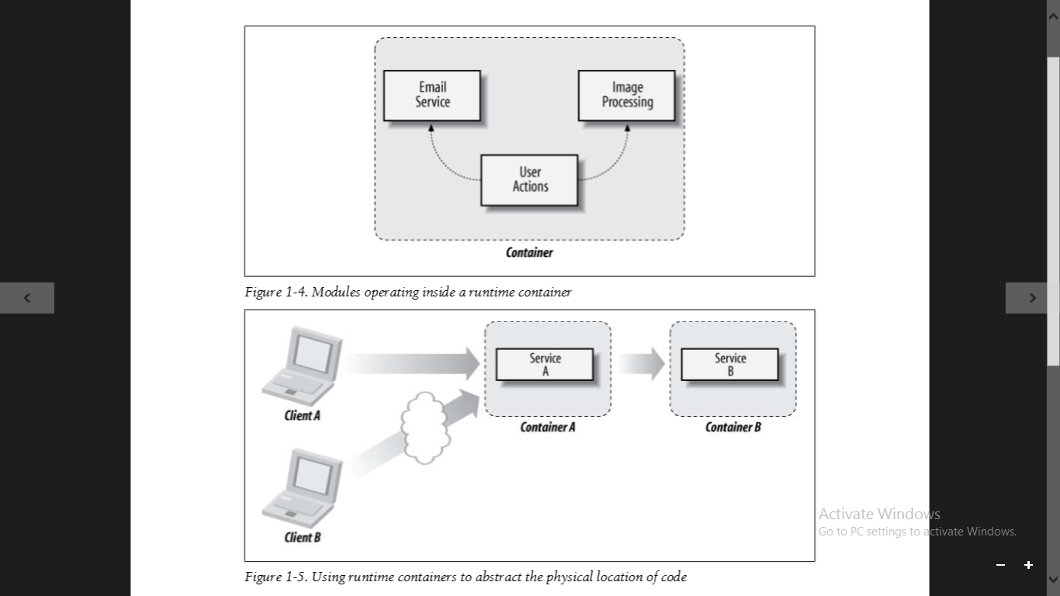

The Container
A Container is
a host that provides services to guest applications.

Slide 19
EJB Specifications [ 3.1 ]
The EJB specification dictates the capabilities required of a compliant EJB Container.
The Enterprise JavaBeans architecture is a architecture for the development and deployment of component-based business applications. Applications written using the Enterprise JavaBeans architecture are scalable, transactional, and multi-user secure. These applications may be written once, and then deployed on any server platform that supports the Enterprise JavaBeans specification.
OR
Enterprise JavaBeans is a standard server-side component model for distributed business applications.

Slide 20
EJB Specifications [ 3.1 ]
EJB defines a model for piecing together a full system by integrating modules. Each component may represent a collection of business processes, and these will run centralized on the server
the “distributed” nature will provide a mechanism to spread modules across different processes, physical machines, or even entire networks
EJB is also an aggregate technology; it wires up other facets of the Java Enterprise Edition. such as messaging, transactions, resource management, persistence, and web services.
(http://java.sun.com/javaee/),

Slide 21
Component Types
Modeling real-life objects and concepts is one of the first skills a programmer must develop.
Because a POJO class is just like any other class, it does not become an EJB until it’s:
1. Assembled/packaged
2. Deployed
3. Accessed via the Container This is an important distinction. EJBs become such only in the context of the EJB Container.
The Container, in turn, is responsible for equipping POJOs with EJB Services

Slide 22
Server Side Component Types
Server-side component types reside exclusively
on the server, and the client must interact with
them via some indirection.
There are two major server-side component
Types:
Session Beans – Which expose a view for
For the client to invoke upon
2. Message Driven Bean – Which act as event
listeners

Slide 23
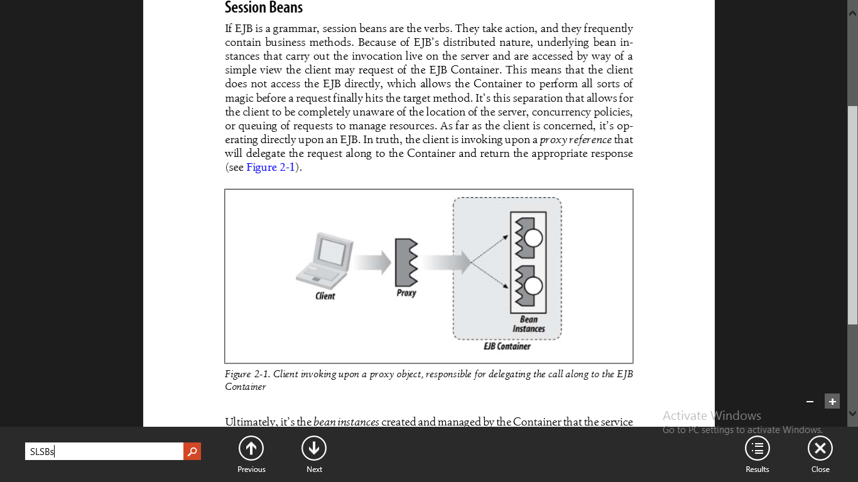
Session Beans
Analogy:-
If EJB is a grammar, session beans are the verbs.
Session beans frequently contain business methods.
The client does not access the EJB directly, which
allows the container to perform all sorts of magic
before a request finally hits the target method.

Slide 24
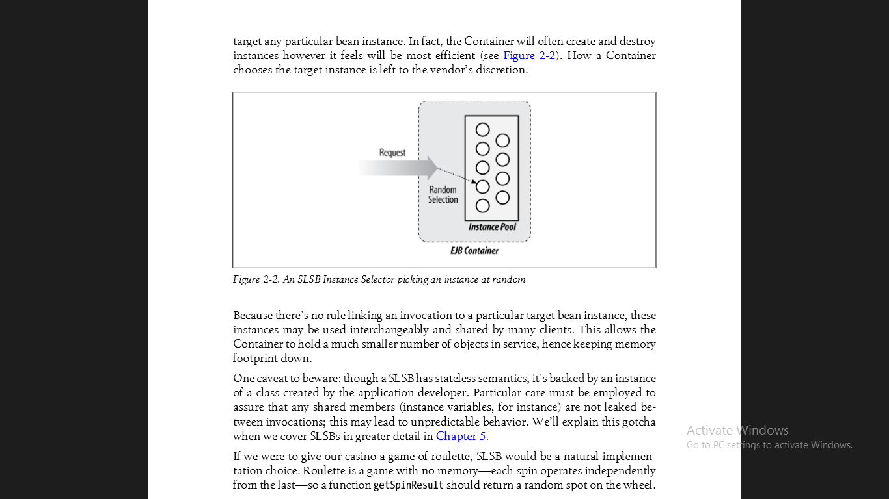
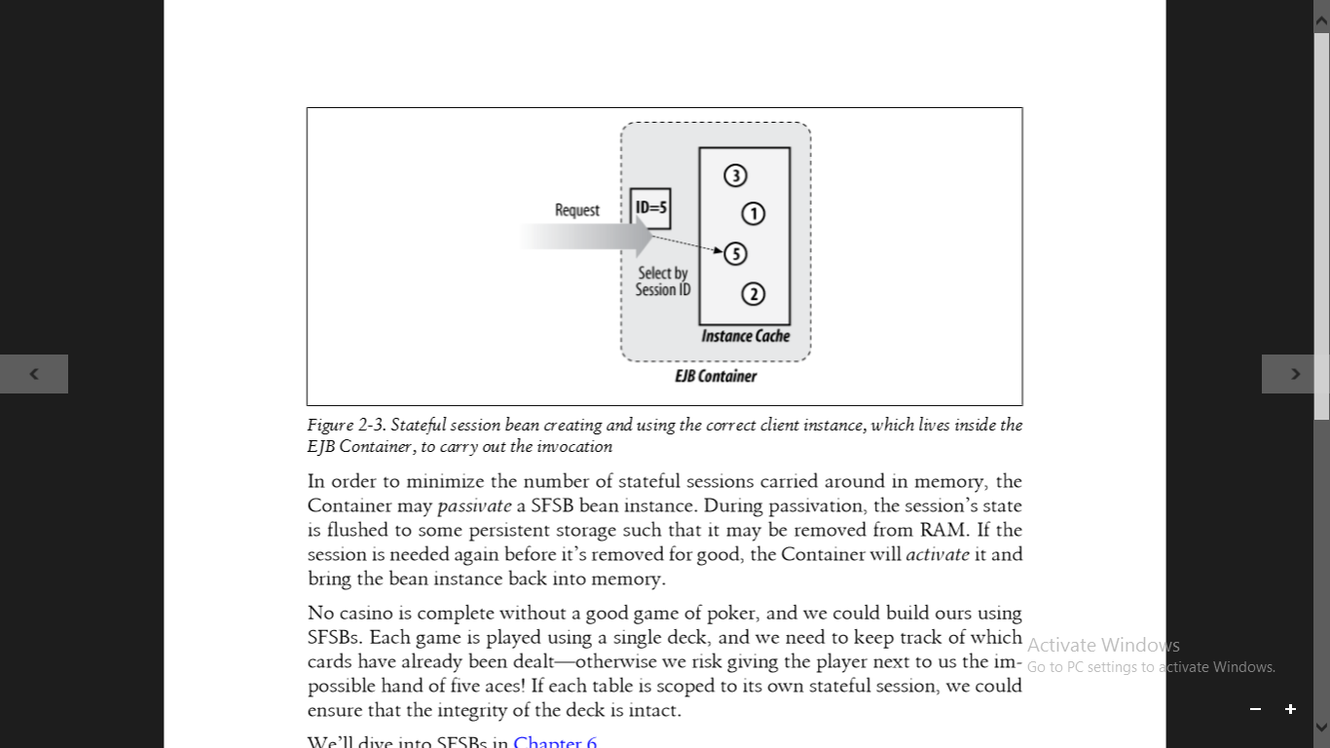
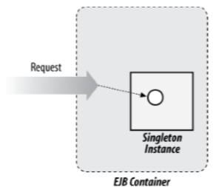
Three types of session Beans:
Stateless Session Beans (SLSBs):
These are useful for functions in which state does not need to be Carried from invocation to invocation
b. Stateful Session Beans (SFSBs)
In this every request upon a given
proxy reference is guaranteed to
ultimately invoke upon the same
bean instance.
c. Singleton Beans: Sometimes we don’t need any more than one backing instance for our business objects. It may be marked to eagerly load when an application is deployed. Therefore it may be leveraged to fire application lifecycle events

Slide 25
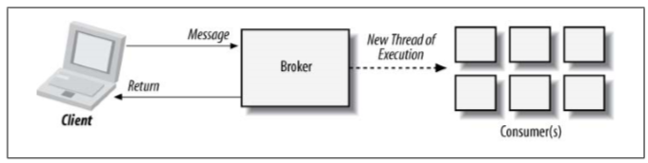
Message Driven Bean (MDBs)
Asynchronous messaging is a paradigm in which two or more applications communicate via a message describing a business event.
EJB 3.1 interacts with messaging systems via the Java Connector Architecture (JCA) 1.6, which acts as an abstraction layer that enables any system to be adapted as a valid sender. The MDB in turn, is a listener that consumes messages and may either handle them directly or delegate further processing to other EJB components.
One common provider of asynchronous messaging is the Java Message Service (JMS). If a message is sent to a JMS Topic or Queue, an MDB may be created to take action upon that event.
Note: Message driven bean also stateless

Slide 26
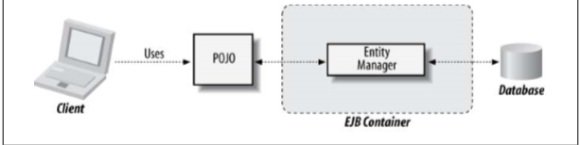
Entity Beans
Analogy:
While session beans are our verbs, entity beans are the nouns
Their aim is to express an object view of resources stored within
a RDBMS – a process commonly known as object-relational mapping
The entity type is modeled as a POJO, and becomes a managed object only when associated with a construct called the javax.persistence.EntityManager

Slide 27
The Java Persistence Model
The sister to the EJB 3.1 Specification is the Java Persistence API (JPA) 2.0, developed in JSR-317 (http://jcp.org/en/jsr/detail?id=317). EJBs may become equipped with the facilities defined by JPA, such that modifying the properties of a managed object will be reflected automatically in the backing database.
In addition to support within EJB, JPA may be used in standalone Java Standard Edition (SE) environments.
Persistence is simply a higher-level abstraction above Java Database Connectivity (JDBC). By exposing the database as objects to the developer, backing rows may be queried, loaded, updated, or removed without explicitly having to go through a contracted API or language such as SQL.

Slide 28
Container Services
Application developers should write the rules of their
business and leave the mechanics of reliable, distributed
systems to middleware providers.
In the case of EJB, the Component Model defines our
interchangeable parts, and the Container Services are
specialists that perform work upon them.
The Specification provides:
• Dependency injection • Concurrency
• Instance pooling/caching • Transactions • Security
• Timers • Naming and object stores • Interoperability
• Lifecycle callbacks • Interceptors
• Java Enterprise Platform integration

Slide 29
Dependency Injection (DI)
A component-based approach to software design brings with it the complication of inter-module communication.
Tightly coupling discrete units together violates module
independence and separation of concerns,
while using common lookup code leads to the
maintenance of more plumbing. Order accept -> process order->
Payment verify -> stock Mgmt -> shipping -> delivery
As EJB is a component-centric architecture,
It provides a means to reference dependent modules in
decoupled fashion. The end result is that you’ll adhere to a
contract and let the container provide the implementation
at deployment time.

Slide 30
In pseudocode, this looks like:
prototype UserModule {
// Instance Member
@DependentModule MailModule mail;
// A function
function mailUser() { mail.sendMail("me@ejb.somedomain");
} }
The fictitious @DependentModule annotation serves two purposes:
• Defines a dependency upon some service of type MailModule. UserModule may not deploy until this dependency is satisfied.
• Marks the instance member mail as a candidate for injection.
The container will populate this field during deployment. Dependency injection encourages coding to interfaces, and not to any particular implementation

Slide 31
Concurrency
Assuming each Service is represented by one instance, dependency injection alone is a fine solution for a single-threaded application; only one client may be accessing a resource at a given time.
However, this quickly becomes a problem in situations where a centralized server is fit to serve many simultaneous requests.
Deadlocks, livelocks, and race conditions are some of the possible nightmares arising out of an environment in which threads may compete for shared resources.
EJB allows the application developer to sidestep the problem entirely thanks to a series of concurrency policies.

Slide 32
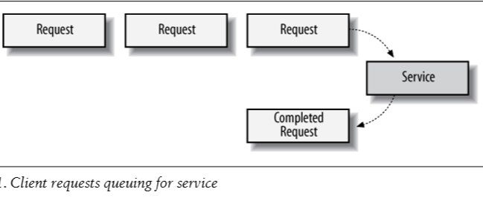
Instance Pooling and Caching
Because of the strict concurrency rules enforced by the Container, an intentional bottleneck is often introduced where a service instance may not be available for processing until some other request has completed.
If the service was restricted to a singular instance, all subsequent requests would have to queue up until their turn was reached

Slide 33
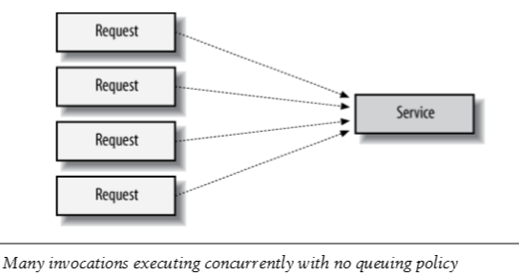
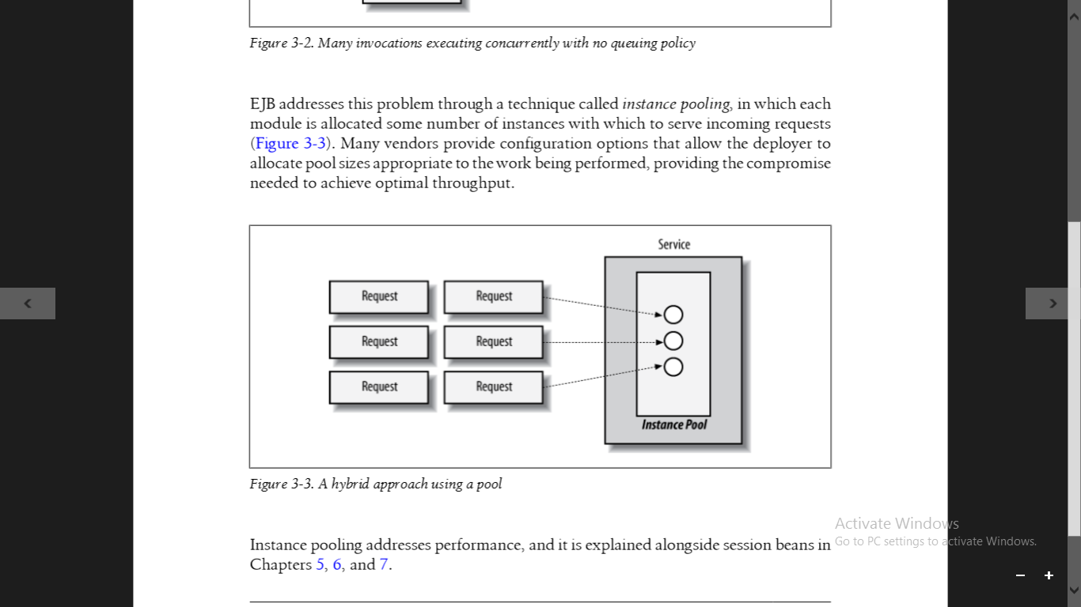
if the service was permitted to use any number of underlying instances, there would be no guard to say how many requests could be processed in tandem, and access across the physical machine could crawl to a halt as its resources were spread too thin.
EJB addresses this problem through a technique called instance pooling, in which each module is allocated some number of instances with which to serve incoming requests.
Many vendors provide configuration options that allow the deployer to allocate pool sizes appropriate to the work being performed

Slide 34
Transactions
Example: Banking Transaction
EJB ensures this via its integration with the Java Transaction Service (JTS) and exposes an API that gives the bean provider (application developer) control over the properties specifying how a transaction-aware application behaves.
EJB developer is required understanding of ACID fundamentals.

Slide 35
Atomicity Every instruction in a call completes or none do. If there’s a failure halfway through, state is restored to the point before the request was made.
Consistency The system will be consistent with its governing rules both before and after the request.
Isolation Transactions in progress are not seen outside the scope of their request until successful completion. Shared resources may not be mutated by two transactions at once.
Durability Once a transaction successfully returns, it must commit to its changes. The system must process the result once a client has received word of normal completion.

Slide 36
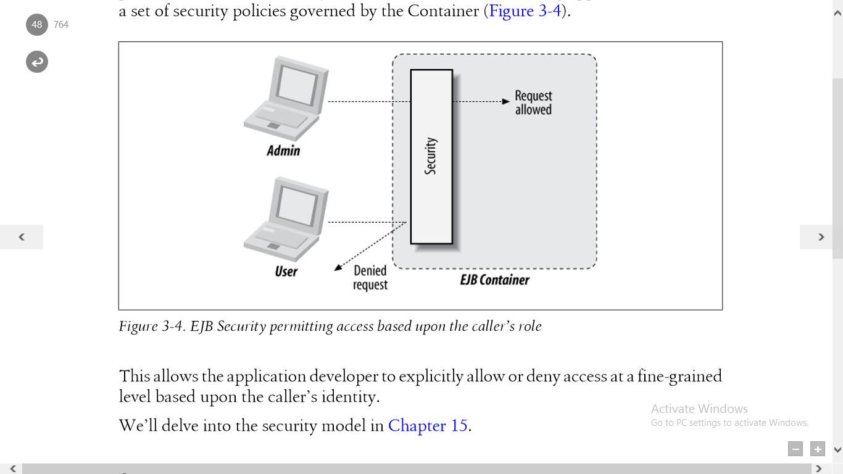
Security
Multiuser applications are likely to expose a wide variety of operations, and not all callers are created equal.
EJB provides a role-based security mechanism that bolsters existing application code with a set of security policies governed by the Container.
This allows the application developer to explicitly allow or deny access at a fine-grained level based upon the caller’s identity.

Slide 37
Timers
For examples:
A ticket purchasing system must release unclaimed tickets after some timeout of inactivity.
An auction house must end auctions on time.
A cellular provider should close and mail statements each month.
The EJB Timer Service may be leveraged to trigger these events and has been enhanced in the 3.1 specification with a natural-language expression syntax

Slide 38
Naming and Object stores
All naming services provide clients with a mechanism for locating distributed objects or resources. To accomplish this, a naming service must fulfill two requirements:
object binding and a lookup API.
Object binding is the association of a distributed object with a natural language name or identifier.
A lookup API provides the client with an interface to the naming system; it simply allows us to connect with a distributed service and request a remote reference to a specific object.
Enterprise JavaBeans mandates the use of Java Naming and Directory Interface (JNDI; http://java.sun.com/products/jndi/) as a lookup API on Java clients.
Java client applications can use JNDI to initiate a connection to an EJB server and locate a specific EJB.

Slide 39
Interoperability
Suppose our application may want to consume data from or provide services to other programs, perhaps written in different implementation languages. There are a variety of open standards that address this inter-process communication, and EJB leverages these.
Interoperability is a vital part of EJB. The specification includes the required support for Java RMI-IIOP for remote method invocation and provides for transaction, naming, and security interoperability. EJB also requires support for JAX-WS, JAX-RPC, Web Services for Java EE, and Web Services Metadata for the Java Platform specifications
Note:
JAXM – Java API for XML Messaging
WS – Web Services
RPC – Remote Procedure Call
RMI – Remote Method Invocation
IIOP

Slide 40
Lifecycle callbacks
Some services require some initialization or cleanup to be used properly.
For example, a file transfer module may want to open a connection to a remote server before processing requests to transfer files and should safely release all resources before being brought out of service.
For component types that have a lifecycle, EJB allows for callback notifications, which act as a hook for the bean provider to receive these events. In the case of our file transfer bean, this may look like:
prototype FileTransferService {
@StartLifecycleCallback
function openConnection(){ ... }
@StopLifecycleCallback
function closeConnection() { ... } }
Here we’ve annotated functions to open and close connections as callbacks; they’ll be invoked by the container as their corresponding lifecycle states are reached.

Slide 41
Interceptors
EJB provides handling of many of the container services, the specification cannot possibly identify all cross-cutting concerns facing your project. For this reason, EJB makes it possible to define custom interceptors upon business methods and lifecycle callbacks.
This makes it easy to contain some common code in a centralized location and have it applied to the invocation chain without impacting your core logic. Say we want to measure the execution time of all invocations to a particular method. We’d write an interceptor:

Slide 42
Platform Integration
As a key technology within the Java Enterprise Edition (JEE) 6 (http://jcp.org/en/jsr/ detail?id=313), EJB aggregates many of the other platform frameworks and APIs:
• Java Transaction Service
• Java Persistence API
• Java Naming and Directory Interface (JNDI)
• Security Services
• Web Services

Slide 43
Developing Your First EJB
EJBs are composed from the following:
Step-1: Bean implementation class (session and message-driven beans)
Step-2: Bean instance (session and message-driven beans)
Step-3: Client view (session and message-driven beans)
Step-4: EJB Proxy (session beans)
Step-5: Local versus remote (session beans)
Step-6: Business interface (session beans)
Step-7: Component interface (session beans)
Step-8: Home interface (session beans)
Step-9:Endpoint interface (session beans)
Step-10:Message interface (MDBs)

Slide 44
Developing Your First EJB continued…1
EJBs are composed from the following:
Bean implementation class (session and message-driven beans)
This class, written by the bean provider, contains the business logic for a session or message-driven bean. It is annotated with the appropriate bean type: @javax.ejb.Stateless, @javax.ejb.Stateful, or @javax.ejb.MessageDriven.
For instance:
@javax.ejb.Stateless
public class MyFirstBean{...}
is all that’s needed to declare an SLSB.

Slide 45
Developing Your First EJB continued…1
Bean instance (session and message-driven beans)
The EJB Container internally contains one or more instances of the bean implementation class to service session or message-driven invocations.
These are not exposed to the client, but are instead abstracted out by way of the client view. Entity bean instances are POJOs that may be created directly by the client using the new operator.

Slide 46
Client view (session and message-driven beans)
Because clients do not invoke upon bean instances directly, this is the contract with which a client will interact with the EJB.
In the case of a session bean, the client view will take the form of a business, component, or endpoint interface—all to be implemented by the EJB Proxy.
Message-driven beans have no client view, as they’re received as messaging events, and entity beans also have no explicit view because clients will interact with a managed object directly.
At least one view must be defined (either explicitly or implicitly) for an EJB.

Slide 47
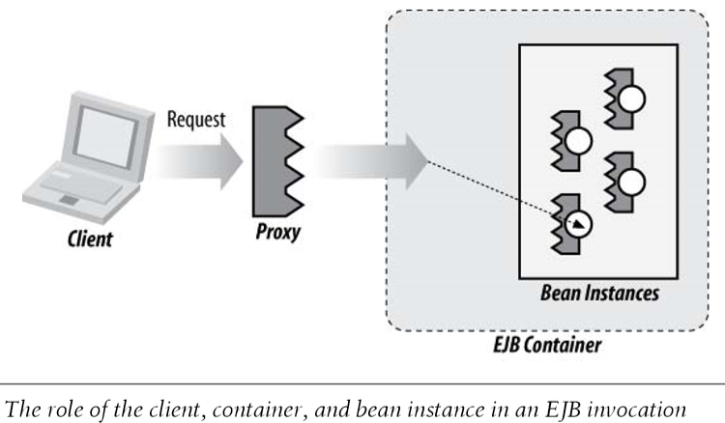
EJB Proxy (session beans)
Session bean clients invoke upon the EJB Proxy, which adheres to the contract defined by the client view. Upon EJB deployment, the Container binds all appropriate Proxy objects into a predefined destination in Global JNDI (EJB 3.1 Specification), where a client may look up the reference.
From the client’s perspective, the proxy is the EJB, though in actuality the invocation mechanism is a bit more involved

Slide 48
Local versus remote (session beans)
The terms local and remote, when referring to business, home, or component interfaces, designate the relationship between the process running the client and the JVM running the EJB Container
Business interface (session beans)
This is the simplified view, introduced in EJB 3.0, defining business methods that are to be supported by session beans.
The business interface is marked as such via an
@javax.ejb.Local or @javax.ejb.Remote annotation, depending upon how it’s to be used.
However, any one interface may not be both local and remote.

Slide 49
Component interface (session beans)
This is the legacy view defined by the EJB 2.x Specification. It has been left in place for backward compatibility with older clients, and it is detailed in EJB 3.1
The Component interface (also known as the “local” or “remote” interface, contrasted with business interfaces, which are called “business local” or “business remote”) must implement javax.ejb.EJBObject or javax.ejb.EJBLocalObject and will additionally define business methods available to the client.
It is obtained via the create<METHOD> methods of the home interface.

Slide 50
Home interface (session beans)
The home interface is used to create, find, and remove session bean references according to the EJB 2.x client contract. Home interfaces extend javax.ejb.EJBHome or javax.ejb.EJBLocalHome and may define methods named with a prefix of “create” to return component interface references.
Just like component interfaces, these are legacy and in place to support backward compatibility.

Slide 51
Endpoint interface (session beans)
The endpoint interface defines business methods that can be accessed from applications outside the EJB container via SOAP.
The endpoint interface is based on Java API for XML-RPC (JAX-RPC) and is designed to adhere to the SOAP and WSDL standards.
The endpoint interface is a plain Java interface that is annotated with the @javax.jws.WebService annotation.

Slide 52
Message interface (MDBs)
Message-driven beans implement the message interface, which defines the methods by which messaging systems, such as the JMS, can deliver messages to the bean.
An MDB that listens to JMS events would therefore be defined like this:
@javax.ejb.MessageDriven(activationConfig={...}) public class MyMessageDrivenBean implements javax.jms.MessageListener{...}

Slide 53
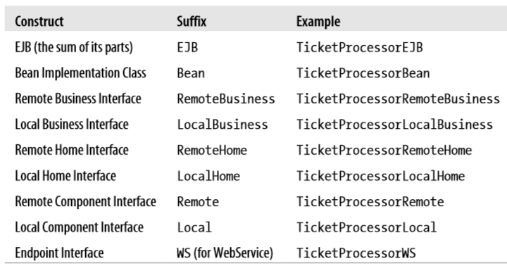
Naming Conventions
An Example EJB that handles ticket processing may contain the term TicketProcessor. All other classes that comprise an EJB may then be named according to the following table:

Slide 62
Models : The statelful Session Bean

Slide 63
Models : The singleton Session Bean

Slide 64
Models : Message Driven Bean

Slide 65
EJB and Persistence

Slide 66
Persistence Entity Manager Mapping

Slide 67
Persistence Objects

Slide 68
Entity Relationships

Slide 69
Question and Answers
Reference Text Book for this Module:
Enterprise JavaBeans 3.1, Andrew Lee, O’Reilly Publishers, 6th Edition
Java Complete Reference, Herbert Schdilt
Thank You
All the best for Examinations

